Slide 1
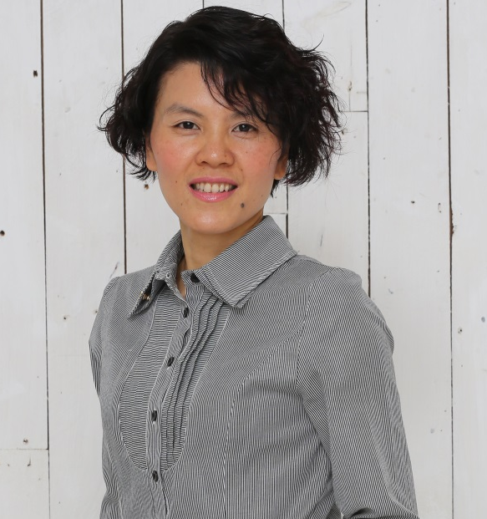
利用購物年金作招募
Recruiting with the Shopping Annuity™
Kawae Cheung
總顧問經理級
National Supervising Coordinator
四個佣金週期共賺取HK$76,600
HK$76,600 in 4 Commission weeks
本簡報中提到的收入等級純屬舉例說明，無意代表美安香港超連鎖™店主的一般收入，也無意表示任何超連鎖™店主皆可賺取同等收入。美安香港超連鎖™店主的成功與否，取決於其在發展事業時的努力、才能與投入程度。The income levels mentioned in the following presentation are for illustration purposes only. They are not intended to represent the income of a typical Market Hong Kong UnFranchise ™Owner, nor are they intended to represent that any given Independent UnFranchise ™ Owner will earn income in that amount. The success of any Market Hong Kong Independent UnFranchise ™ Owner will depend upon the amount of hard work, talent, and dedication which he or she devotes to building his or her Market Hong Kong Business.

Slide 2

利用購物年金作招募
Recruiting with the Shopping Annuity™

Slide 3

心法 - 甚麼來的
What is the key?
年金 vs 購物年金
Annuity vs Shopping Annuity

Slide 4





購物年金
轉消費為收入
Shopping annuity
Convert Spending Into Earning
讓花錢的消費
變成賺錢的事業
Convert your spending
into investment

Slide 5
想法 -真的嗎
Is this real?
消費轉為收入
永續收入
Convert Spending Into Earning
Ongoing Income

Slide 6
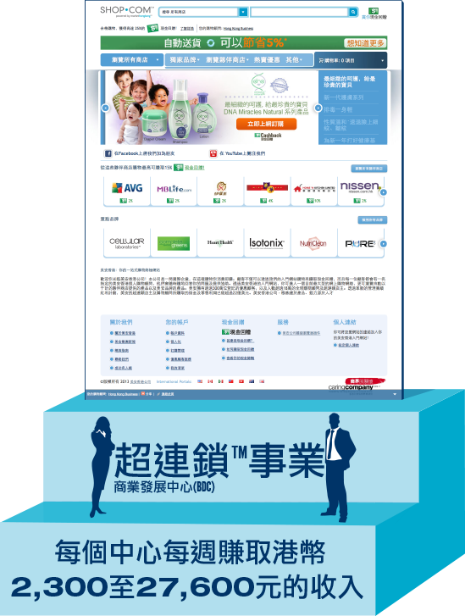
投資收入 invest income
儲蓄收入Saving interest
股票基金Stocks & funds
儲蓄Savings
投資 Investment
銀行 Bank
打工收入Salary
2到3年計劃
The 2-3 Year Plan
支出Spending
超連鎖™事業
UnFranchise™ Business
永續收入Ongoing Income
MPCP(管理業積紅利計畫)

Slide 7


你本來就在消費…
You’re Already Spending It…
何不將你的消費轉為收入？
Why Not Convert Your Spending Into Earning?

Slide 8
做法 -怎做到的
How to do
- 自己家庭
- 一對一
- 社交媒體
- 持續
- 複製
- Family
- One-to-one
- Social media
- Constantly
- Duplication

Slide 9


你的每月消費與平均每月消費額比較相差多少？
How does your monthly spending compare to the average monthly spending?
食物Food
住屋Housing
每年總消費額
Annual Total
服裝與服務Apparel & Service
$175,044
交通Transportation
健康護理Healthcare
進入ShoppingAnnuity.com以完成你的
購物年金評量
Visit ShoppingAnnuity.com to complete the Shopping Annuity Assessment
娛樂Entertainment
平均每月消費額
Monthly Total
個人護理產品及服務Personal Care Product & Service
$14,587
閱讀Reading
雜項MISCELLANEOUS

Slide 10

落實購物年金，從每一位超連鎖™店主完成購物年金評量開始
THE SHOPPING ANNUITY BEGINS WITH EACH UFO COMPLETING THE
SHOPPING ANNUITY ASSESSMENT
1
  購買美安獨家代理產品帶來BV
  Create BV with our Exclusive Brands
4
2
  購買美安HK.SHOP.COM夥伴商店產品帶來IBV
  Create IBV with Partner stores on SHOP.COM
個簡單步驟建立
STEPS To BUILD A
3
  開展複製
  Create Duplication
購物年金
SHOPPING ANNUITY®
4
  透過優惠顧客建立BV & IBV
  Create BV & IBV with Customers

Slide 11


如何開始建立購物年金？
How Do You Build Your Shopping Annuity™?
從改變你的購物習慣開始
It Begins by Adjusting Your Shopping Behaviors

Slide 12





一對一關係行銷
One-to-one Relationship Marketing
Listen
Share
Recommend
聽聽人們的需要
確定需要
推薦產品和服務
發送產品連結或更多資訊
分享故事或見證
For people that have a need
Identify need
Story or testimonial
Product or service
Send link to product
or more information

Slide 13
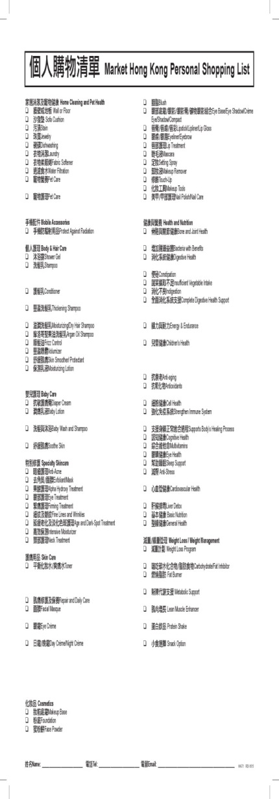
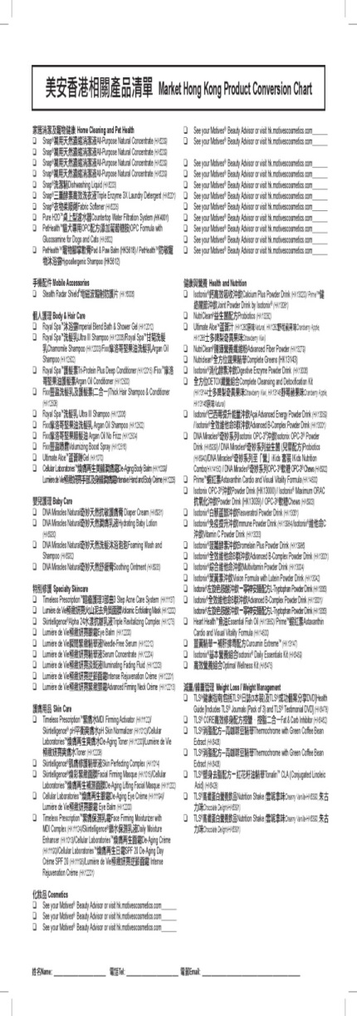
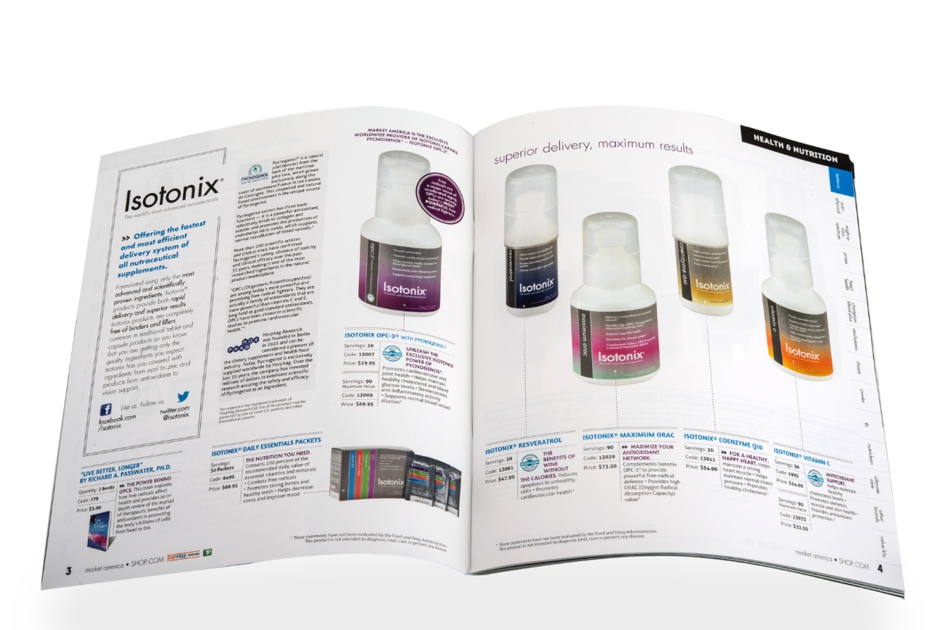
美安香港產品目錄
MHK Product Catalog

Slide 14
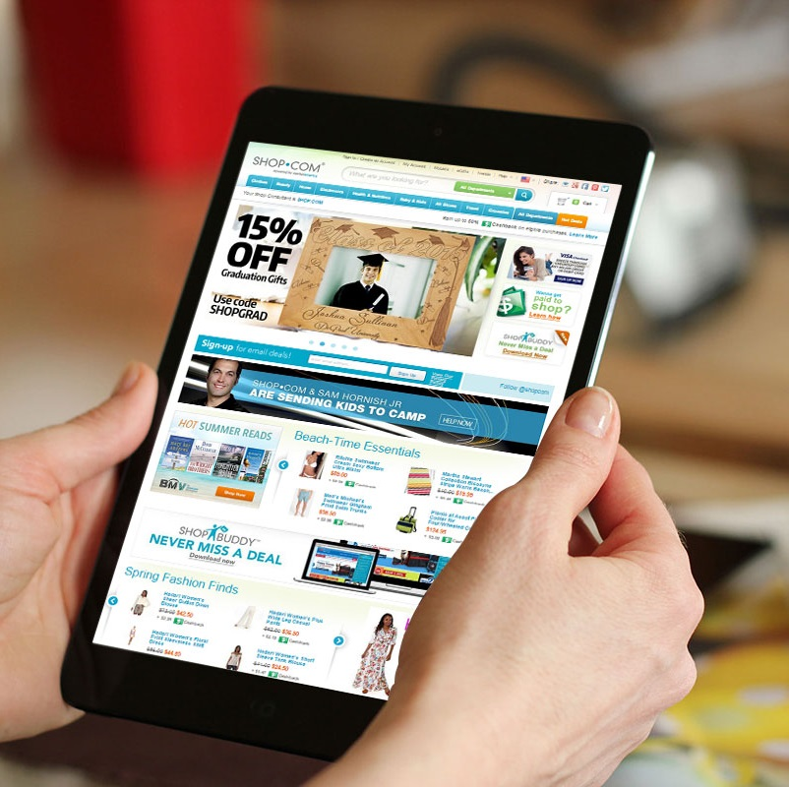
  使用你的網站
  Use your website
  分享你的網站
  Share your website
了解你的
HK.SHOP.COM網站
Learn Your
SHOP.COM Websites

Slide 15
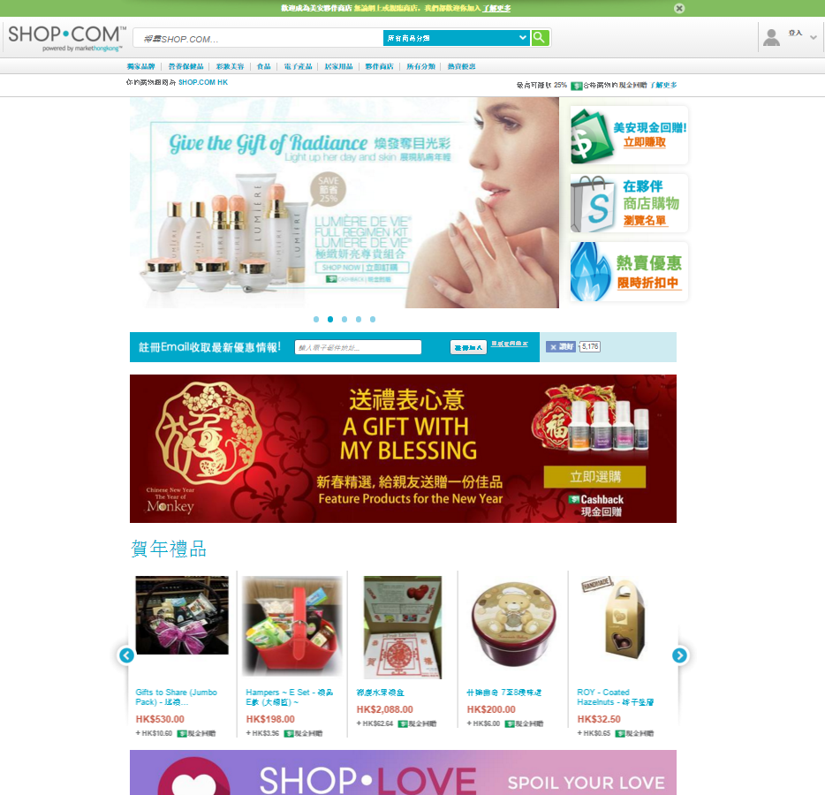


網際網路行銷公司
AN INTERNET MARKETING COMPANY
購買美安品牌商品以及附有現金回贈標誌的夥伴商店產品，賺取多達 25%的現金回贈。
Earn up to 25 percent Cash Back for purchasing markethongkong™ branded products and those from our Partner Stores where you see the Cashback logo
50%
每次引薦他人合格購物 都可讓你獲得0.5%現金回贈。Earn ½ percent on eligible referral purchases
½%
你及你的顧客可以進入購物的商店超過1300家 More than 1300 Partner Stores for you and your customers
現金回贈可助你賺取更多收入Earn more with Cashback

Slide 16

社交媒體Social Media
前所未有的世上最大引薦計劃
The WORLD’S largest referral program in history

Slide 17
20%
80%
事業內容
Business
個人內容
Personal
社交媒體應用作社交之用。
如果你所有的貼文只是涉及事業而忽略社交，你的朋友們可能會不願和你來往。
Social Media should be social.
If all you post about is business, than you are not socializing and your friends may tune you out.
記往，你在營造自己的品牌，你不是一個單一品牌、公司或主修科目，你是你自己！
Remember, you are branding YOU.
You are not a single brand, company or major,
You are YOU.

Slide 18

這是甚麼 What’s that
你在做甚麼
What are you doing
SHOP.COM是甚麼
What is SHOP.COM
你為甚麼而做
Why are you doing

Slide 19





目標
Objectives
建立你的購物年金
Create your Shopping Annuity
發展10-15人的「忠實顧客基礎」，每位顧客每月購買
30 BV/20 IBV以上的
產品。
Develop a 10-15 repeat customers
who purchase ≥
30 BV/20 IBV monthly
建立顧客佔有率
Building share of customer
顧客轉移到合作
Retail to recruit

Slide 20
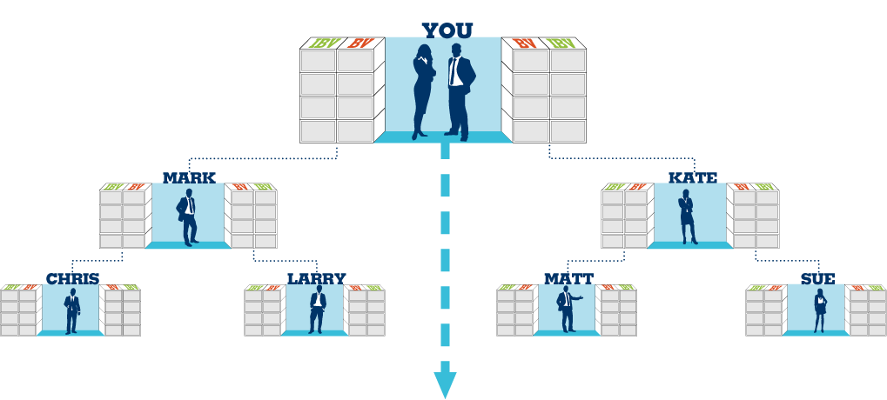
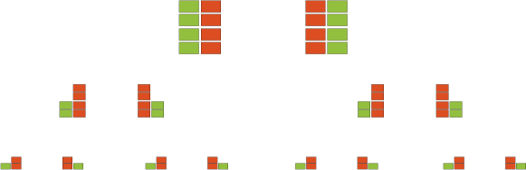
購物年金
每位超連鎖™店主每月500 BV + 200 IBV
基本10顧客
每位超連鎖™店主的10位優惠顧客產生
300 BV + 200 IBV
總額 = 每位超連鎖™店主800 BV + 400 IBV
Shopping Annuity
500 BV + 200 IBV monthly per UFO
Base 10
300 BV + 200 IBV x 10 PCs per UFO
Total = 800 BV + 400 IBV per UFO
組織完成購物年金及基本10顧客
Organization Satisfying the Shopping Annuity™ and base 10
佣金 = 每月HK$64,400 (BV)及每月 HK$46,000 (IBV)
Commissions = HK$64,400monthly (BV) and HK$46,000 monthly (IBV)
= HK$110,400
每個週期你可由BV賺取$16,100及每個週期由IBV賺取$11,500
You should earn HK$16,100 weekly (BV) and HK$11,500 weekly (IBV)
50 UFO’s x 800 BV = 每月40,000 BV Monthly
加上
Plus
50 UFO’s x 400 IBV = 每月20,000 IBV Monthly
50 UFO’s x 800 BV =每月40,000 BV Monthly
加上
Plus
50 UFO’s x 400 IBV =每月20,000 IBV Monthly
此投影片上BV及IBV庫顯示週期業績累積
BV and IBV banks on this slide display weekly volume accruals

Slide 21
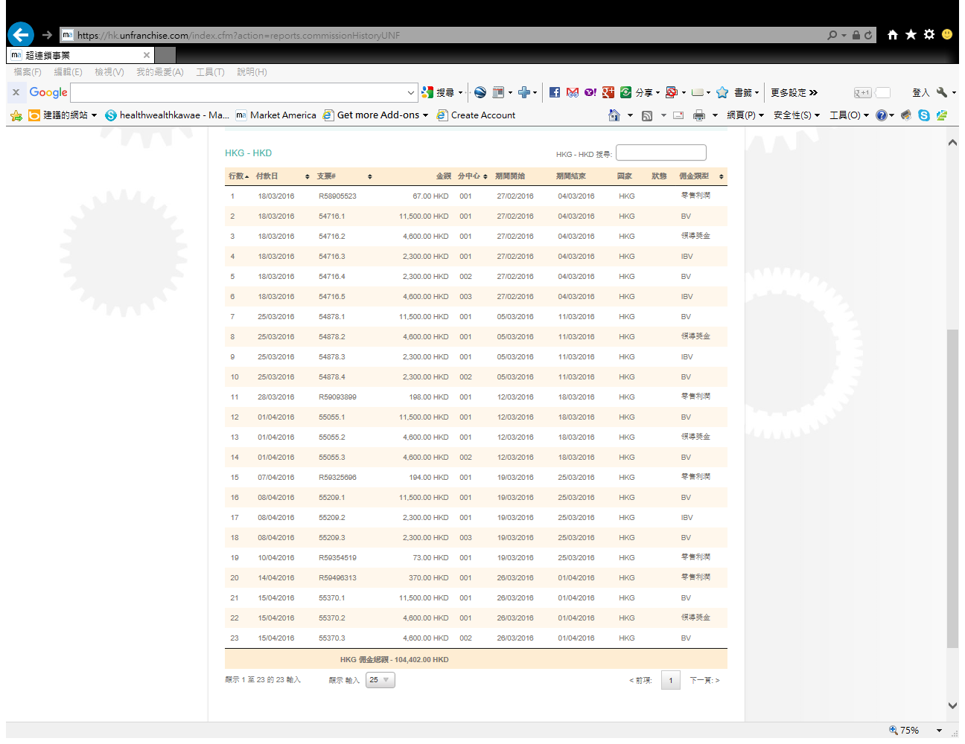
永續收入
Ongoing Income

Slide 22
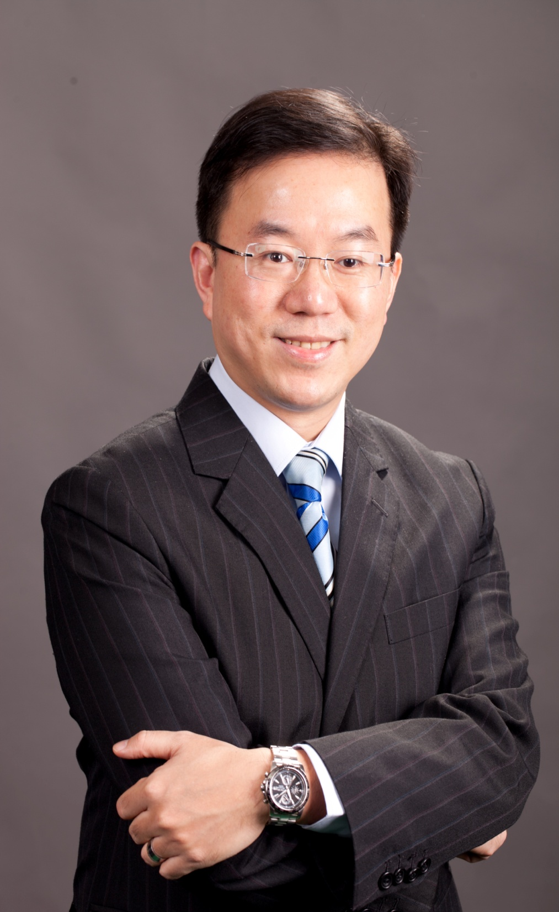
畢業於香港中文大學
Graduated in the Chinese University of HK
主修社會工作、副修心理學
Major in Social Work, Minor in Psychology
畢業後於社會福利機構擔任社會工作主任
Employed as Social Welfare Officer After Graduation
1997 – 2012 跨國保險公司業務經理
Business Manager -
Multinational Insurance Company
2012 – 現在 保險經紀公司資深顧問
Senior Consultant –
Insurance Broker Company
2013年9月 加盟美安香港 (Join in)
2014年1月 晉升為助理級(C)
2014年3月 晉升為經理級(EC)
2014年8月 晉升為主管經理級(MC)
2014年10月 晉升為資深主管經理級(SMC)
2015年4月 晉升為資專業經理級(PC)
2015年10月 晉升為顧問經理級(SC)
William Chan
顧問經理級
Supervising Coordinator
四個佣金週期共賺取HK$57,500
HK$57,500 in 4 Commission weeks

Slide 23
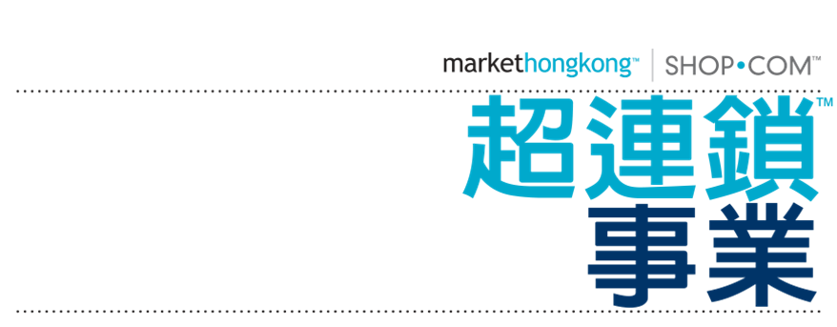
美安 HK.SHOP.COM
超連鎖事業
有價值嗎？
Market Hong Kong, HK.SHOP.COM, UnFranchise™ Business
Are they valuable?
Notes:
我是William 陳智偉，香港中文大學畢業後有九年受薪的工作。
95和96年我和太太兩年抱兩，不想再花八九成的美國、大陸跑，
在97年，我開始展自顧工作，加盟一家跨國的保險公司從事保險理財工作。
這樣，可以留港工作，陪伴孩子成長，
也開始嘗試替我客戶建議和安排不同的理財計劃，賺取我的收入。
時間過得很快，大女已經是大學三年的學生，細仔在英國讀大學一年級。
兩年半前我有計劃接觸了美安香港Shop.Com 的超連鎖事業計劃，
作為一個理財顧問，我很認真的評估背後的生意模式，
也評估經營Shop.Com的價值。

Slide 24


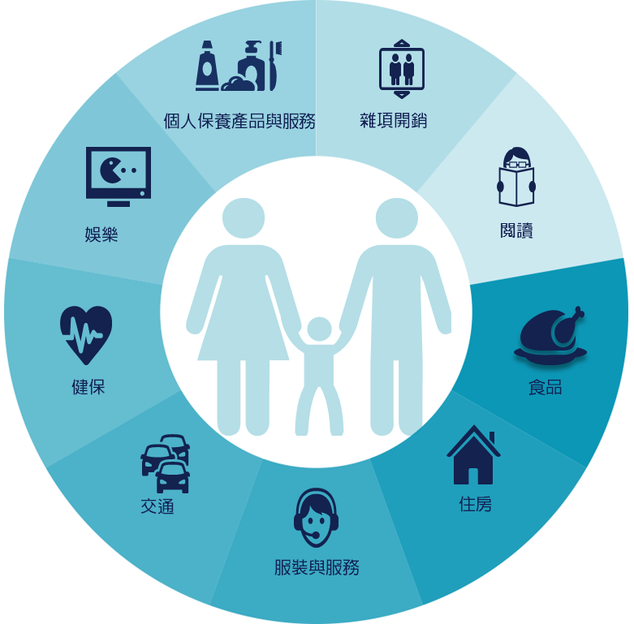

購物年金
Shopping Annuity™
轉消費為收入的成功計劃
A Proven plan of
convert spending into earning
Notes:
就在兩年前差不多是這個時間，
我就在那次的大會中聽到 購物年金 這四個字。
過去二十年來，我其中一個工作就是幫我的客戶設計年金(即食常糧)計劃，
因為能夠做到像舊制公務員一樣，長食長有，當然很好。
但我過去的經驗中，要有一個丰裕的年金，要投放的投資和儲蓄實在不少。
在我過去接觸的客戶中，有些一個月儲蓄起一兩千元，已經算不錯；
偶爾一些較高薪的客戶，每月儲蓄一萬；二十年後本金240萬，4%回報的結餘也只是360萬左右。(每月$12,000洗@4%)
當我聽到 用購物 ， 可以變成年金。我當是真的是一頭霧水。
只是需要把日常消費的轉移，就可以變成年金。

Slide 25

以4%利率，必須有多少存款才能擁有等值被動收入
Will you have this cash invested in the bank at today’s rates ?
超連鎖™永續收入 UnFranchise™ Ongoing Income | 4%的投資法則Equivalent Investment earning at 4%
$4,600 / Month (經理級Executive coordinator/ 主管經理級Master) | $1,380,000
$34,500 / Month (專業經理級Professional coordinator) | $11,040,000
$76,600 / Month (總顧問經理級National supervising) | $24,512,000
$138,000 / Month (高級顧問經理級Director) | $44,850,000
$276,000 / Month ( 副總裁級Field Vice President) | $92,000,000
超連鎖™收入
UnFranchise™ Income
vs.
4% 投資報酬率
The 4% Rule Investment
Notes:
TRAINERS NOTES:
The 4% Rule is a popular investment-income strategy that says as long as you withdraw no more than 4% of your initial portfolio, adjusted for inflation, on an annual basis during your retirement years, you shouldn't run out of money.
Take a look at what it would take to create a $1,500/month payment to yourself at retirement, following this rule. It would take $450,000 in the bank! Would you have that money saved up by retirement?
Most Americans are living paycheck to paycheck with little to no savings. How will they get it done? The answer is that most won’t, and therefore will never have the 4% rule as a viable retirement option.
With Market America, you could create a $1,500 / month asset as an executive coordinator or master coordinator. And even more, after 2-3 years of following our proven plan you could create a residual income of $187,000 / year. That is the equivalent of living off of 4% of a $5MILLION asset in the bank!
Think even further – if you built the UnFranchise as a way to enjoy residual income because you didn’t have the savings to participate in the 4% rule, now you can create the savings and earn both – the Residual Income from your UnFranchise and the 4% off the income you save!

Slide 26


Slide 27

利用購物年金作招募
Recruiting with the Shopping Annuity™
Helen Lin
總顧問經理級
National Supervising Coordinator
四個佣金週期共賺取HK$76,600
HK$76,600 in 4 Commission weeks
本簡報中提到的收入等級純屬舉例說明，無意代表美安香港超連鎖™店主的一般收入，也無意表示任何超連鎖™店主皆可賺取同等收入。美安香港超連鎖™店主的成功與否，取決於其在發展事業時的努力、才能與投入程度。The income levels mentioned in the following presentation are for illustration purposes only. They are not intended to represent the income of a typical Market Hong Kong UnFranchise ™Owner, nor are they intended to represent that any given Independent UnFranchise ™ Owner will earn income in that amount. The success of any Market Hong Kong Independent UnFranchise ™ Owner will depend upon the amount of hard work, talent, and dedication which he or she devotes to building his or her Market Hong Kong Business.

Slide 28
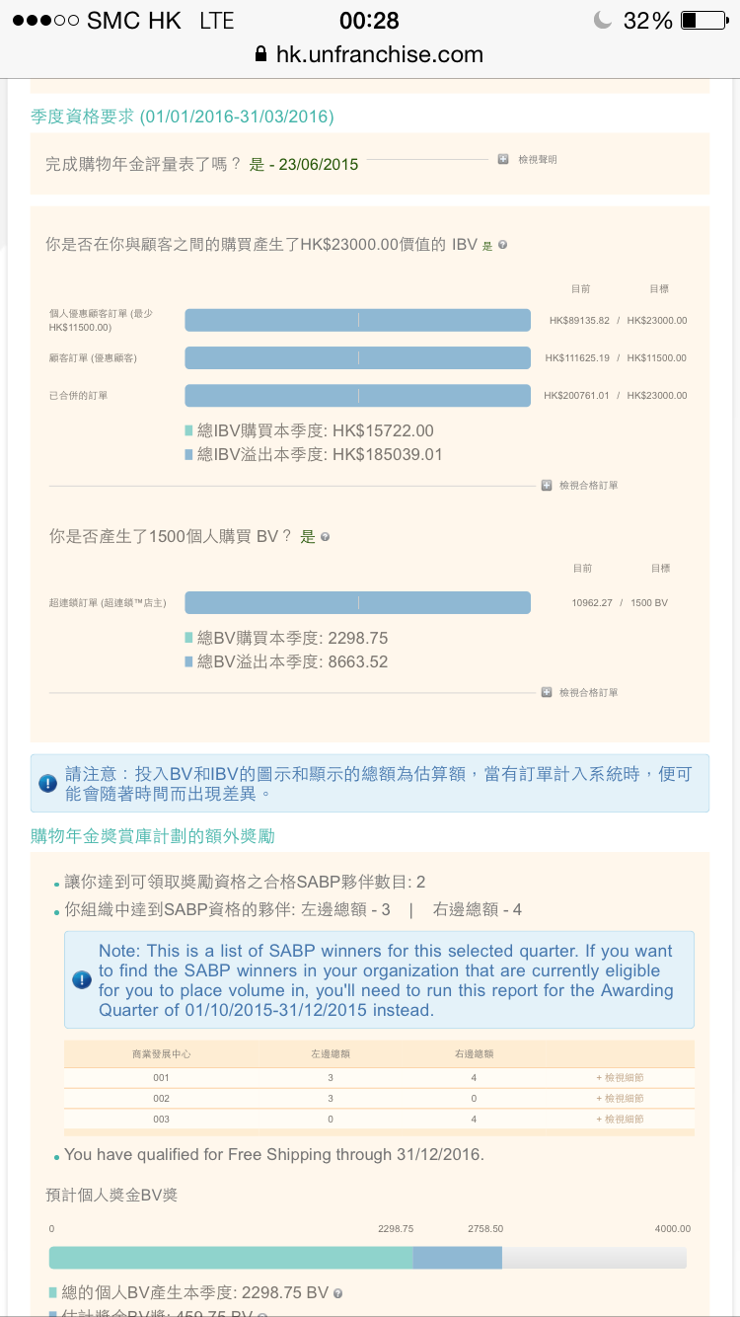

Slide 30
這是你的選擇
It’s Your Choice
你可以繼續消費，
幫別人、幫別的公司賺錢
You can continue to spend money and make other companies and people money
你也可以透過購物年金，
轉消費為收入，幫自己賺錢
You can Convert Your Spending into Earning with the Shopping Annuity® and help make yourself money?
或OR
你想要哪一種﹖Which do you Prefer?

Slide 31
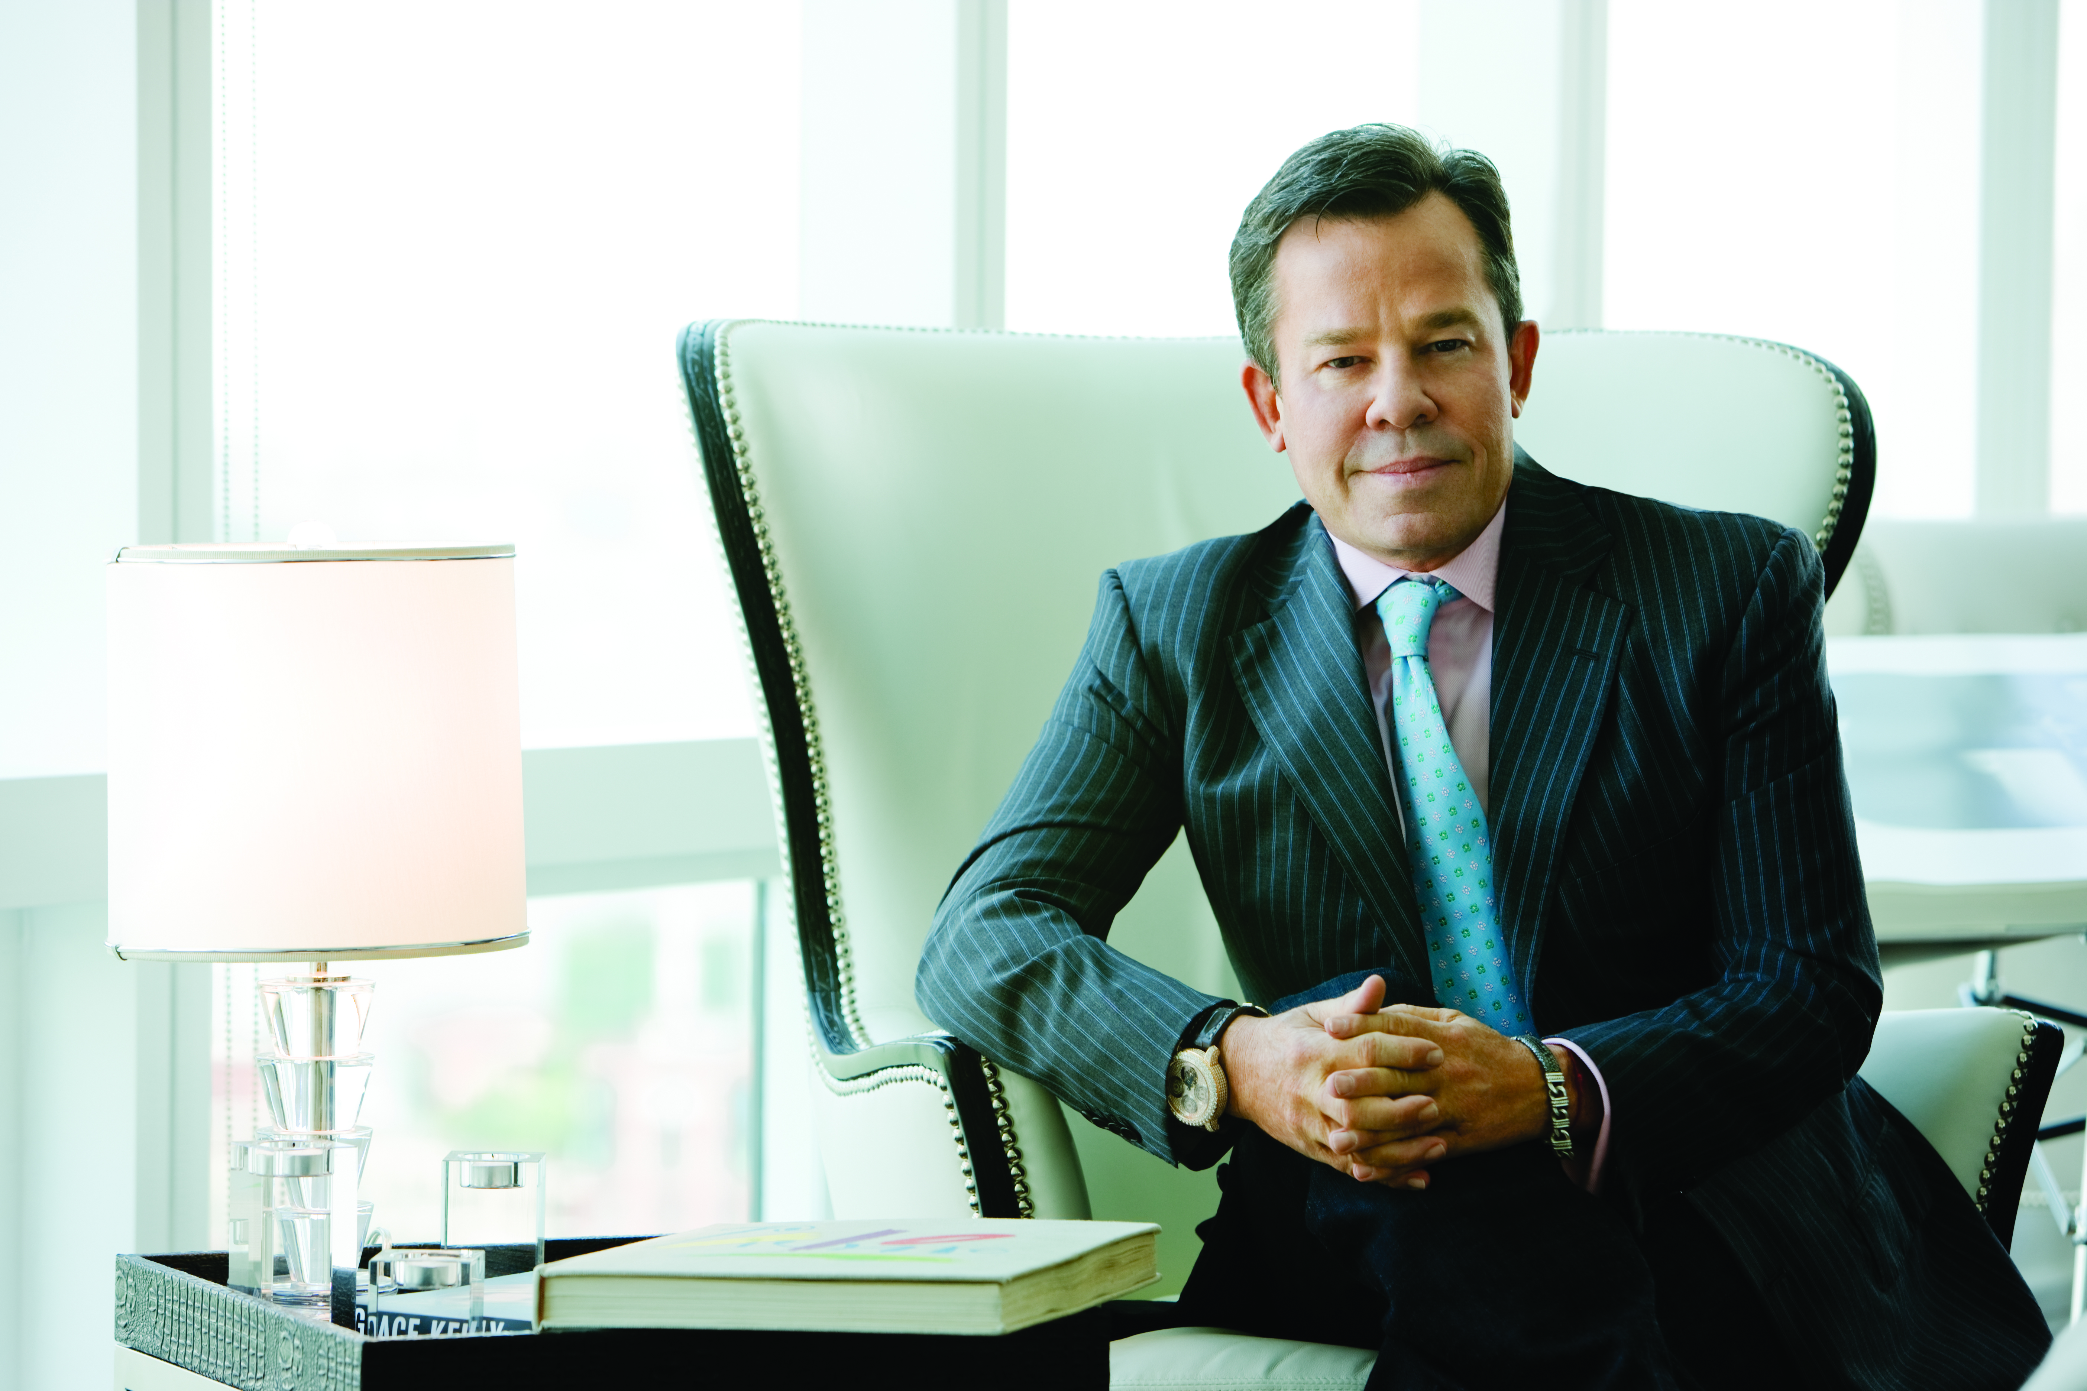
以身作則。
你必須成功，其他人才能實現他們的夢想。
Lead by example.
You must succeed so
other people can
realize their dreams.
JR Ridinger
美安集團主席及行政總裁

Slide 32


轉消費為收入
化信念為力量
Convert Spending Into Earning
Convert your faith into power

